Slide 1
Model-based Integrated Planning and Control of Autonomous Vehicles using Artificial Potential Fields with uncertain environment
Emilio Benenati
Josyula Viswanath Das
10th January 2022

Slide 2
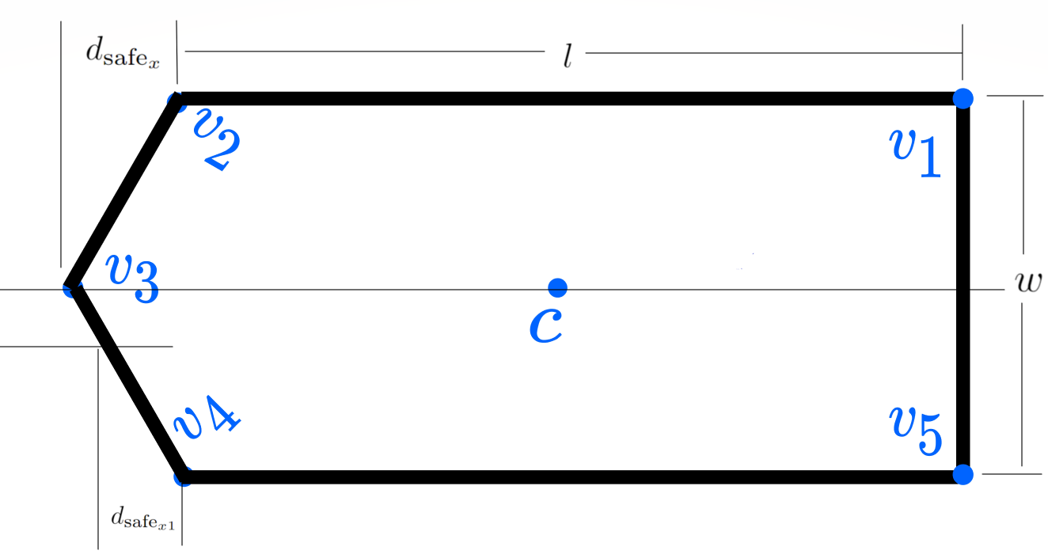

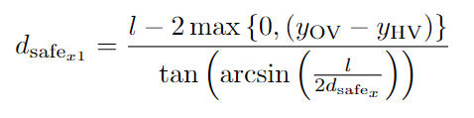


Slide 3
Problem we had with the above problem is that both the square of the velocity which is a chi-squared distribution as well as the position which is a gaussian distribution is both used to define a safe region which the vehicle can move in.
One idea is to use uncertainty in position and not consider the uncertainty in velocity.
There are other formulations of the safe distance formula but the one which is on the last slide is the one which represents the distance travelled properly.
The problem here is that the safe region is already being generated by the APF function so I do not think there is a need for this safe region.

Slide 4
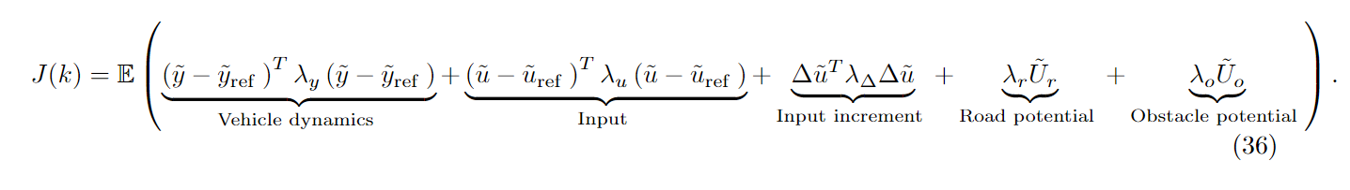
Another idea is to use just the expectation of the objective function and not any constraint. Thought I have never seen this formulation before we could just do
and then find an equivalent deterministic expression.

